Slide 1
EEG Multimodal

Slide 2
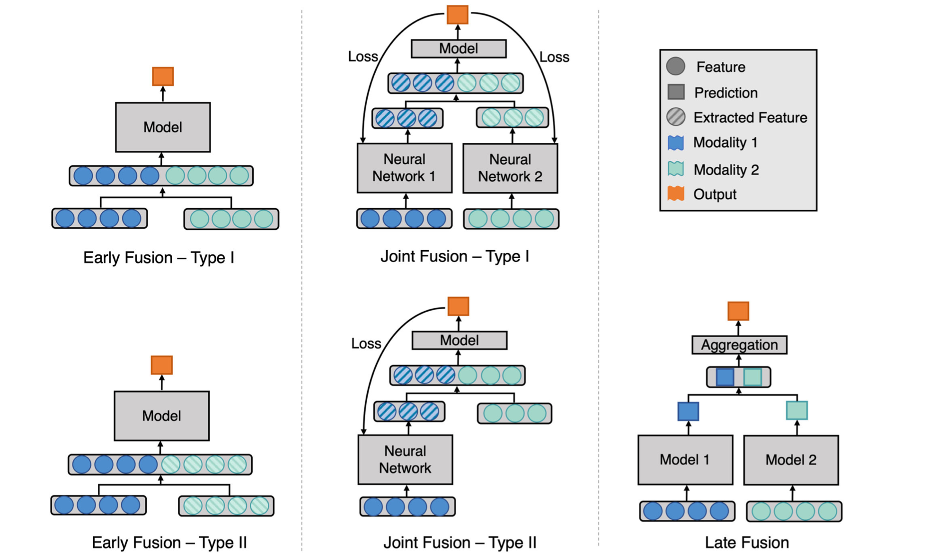
Multimodal Models https://www.nature.com/articles/s41746-020-00341-z

Slide 3
Multimodal Models https://www.nature.com/articles/s41746-020-00341-z
IN THIS PROJECT

Slide 4
EEG Models

Slide 5
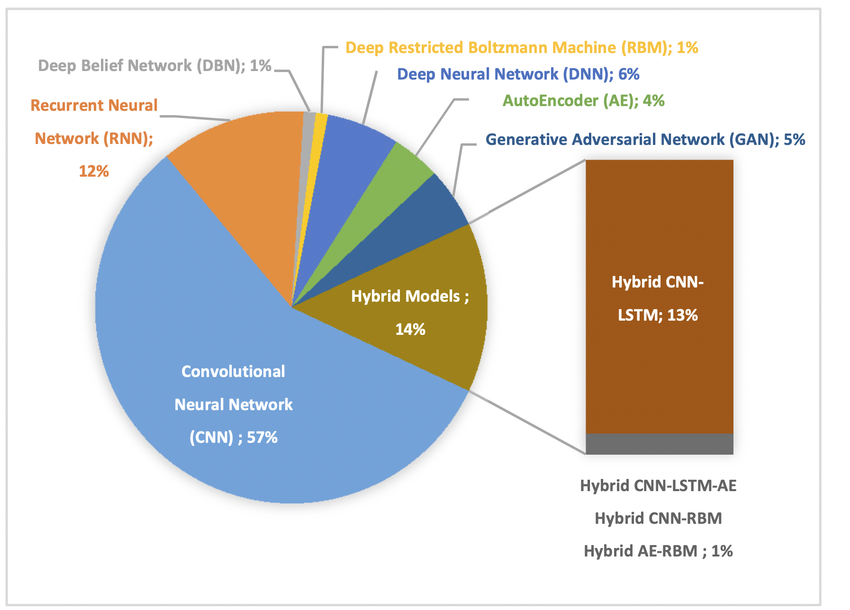
EEG signal analysis using deep learning: A systematic literature review https://ieeexplore.ieee.org/abstract/document/9626707

Slide 6
Deep Convolutional Neural Network Model for Automated Diagnosis of Schizophrenia Using EEG Signals https://www.mdpi.com/2076-3417/9/14/2870
Task: Binary classification (yes/no Schizophrenia)
Results:
accuracy = 98.07%
sensitivity (recall) = 97.32%
specificity = 98.17%
positive predictive value = 98.45%
EEG signals
19 channels, sampling frequency 250Hz
Z-score normalization
Signals were segmented
Each segment consisted of a 25 s (6250 sample) window length
Each segment consisted of 6250 × 19 sampling points
A total of 1142 EEG segments were used

Slide 7
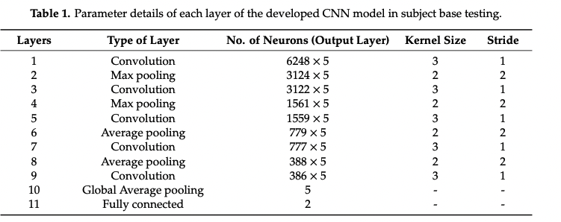
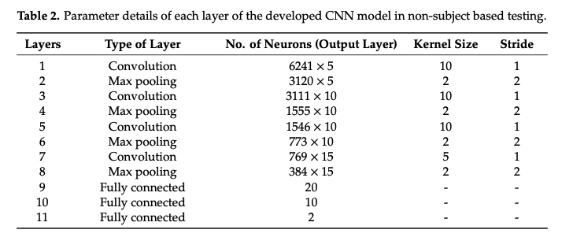
Model layers
convolution
batch normalization
max pooling
average pooling
global average pooling
dropout (p=0.5)
Leaky Relu
Softmax
Model training
Adam
learning rate = 0.001
50-70 epochs
k-fold cross-validation

Slide 8
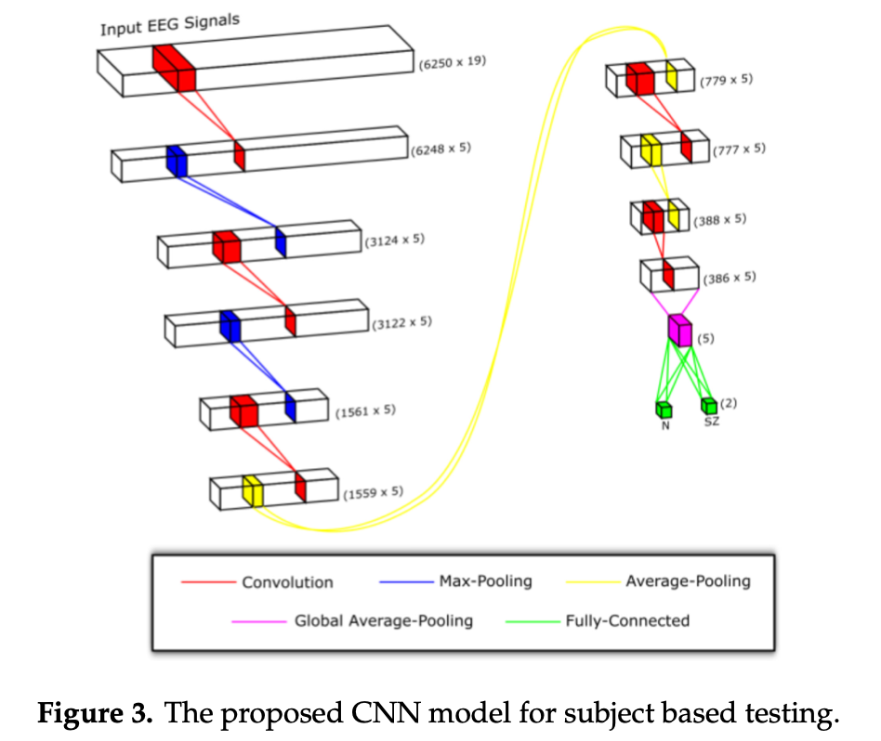
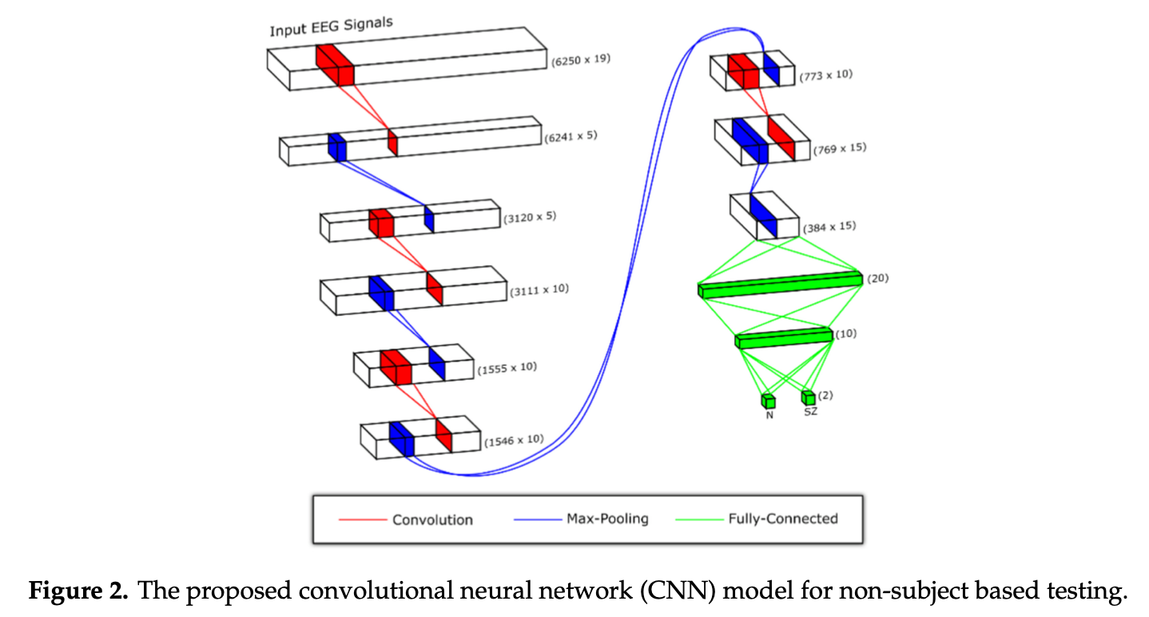

Slide 9
A deep convolutional neural network model for automated identification of abnormal EEG signals https://link.springer.com/article/10.1007/s00521-018-3889-z
Task: Binary classification (abnormal/normal signal)
Results:
classification error rate of 20.66% in classifying the normal and abnormal EEG signals.
EEG signals
1 channel (T5-O1 and F4-C4), sampling frequency 250 Hz
The first 60s sections of each EEG record were used (15000 data points)
2 steps normalization
the signals are normalized to 0 - 1.
the signals were standardized by removing the mean and scaling to unit variance

Slide 10
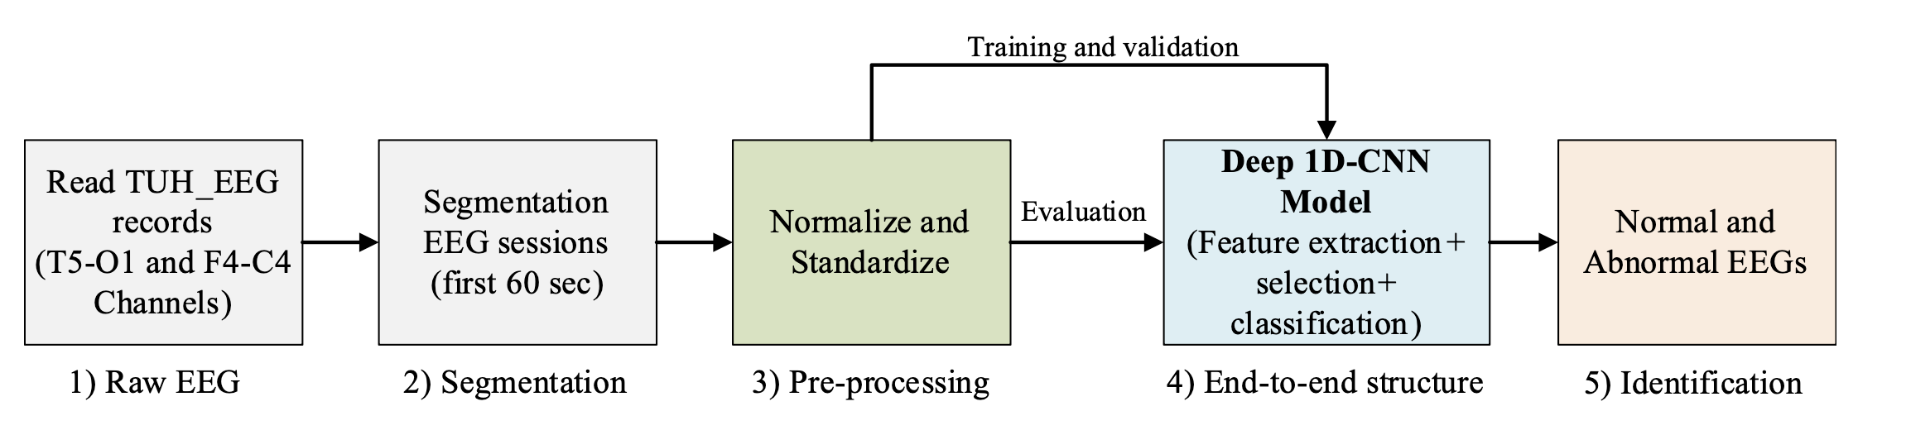
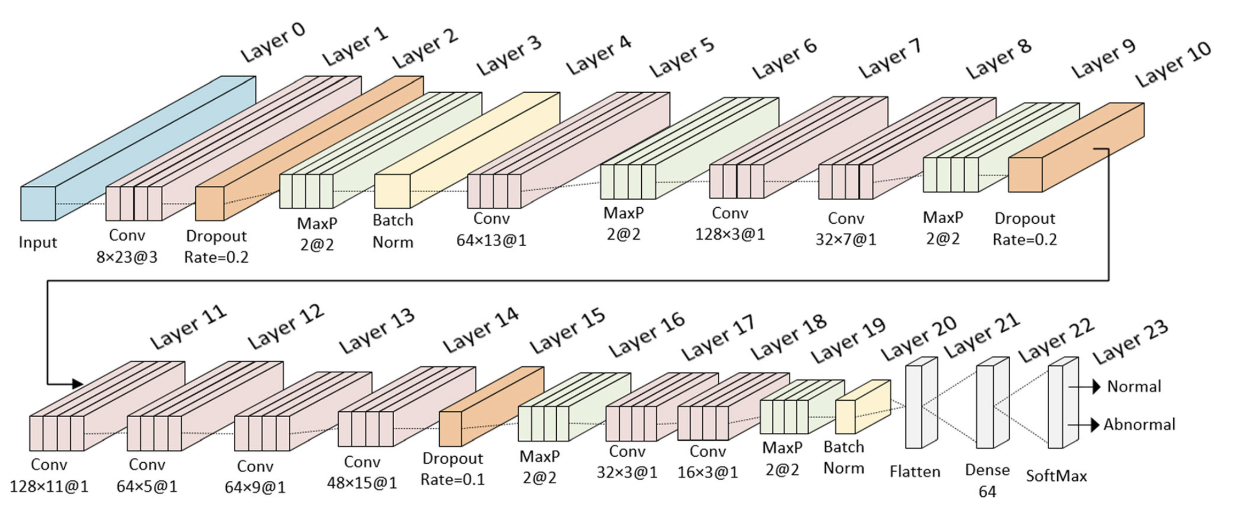

Slide 11
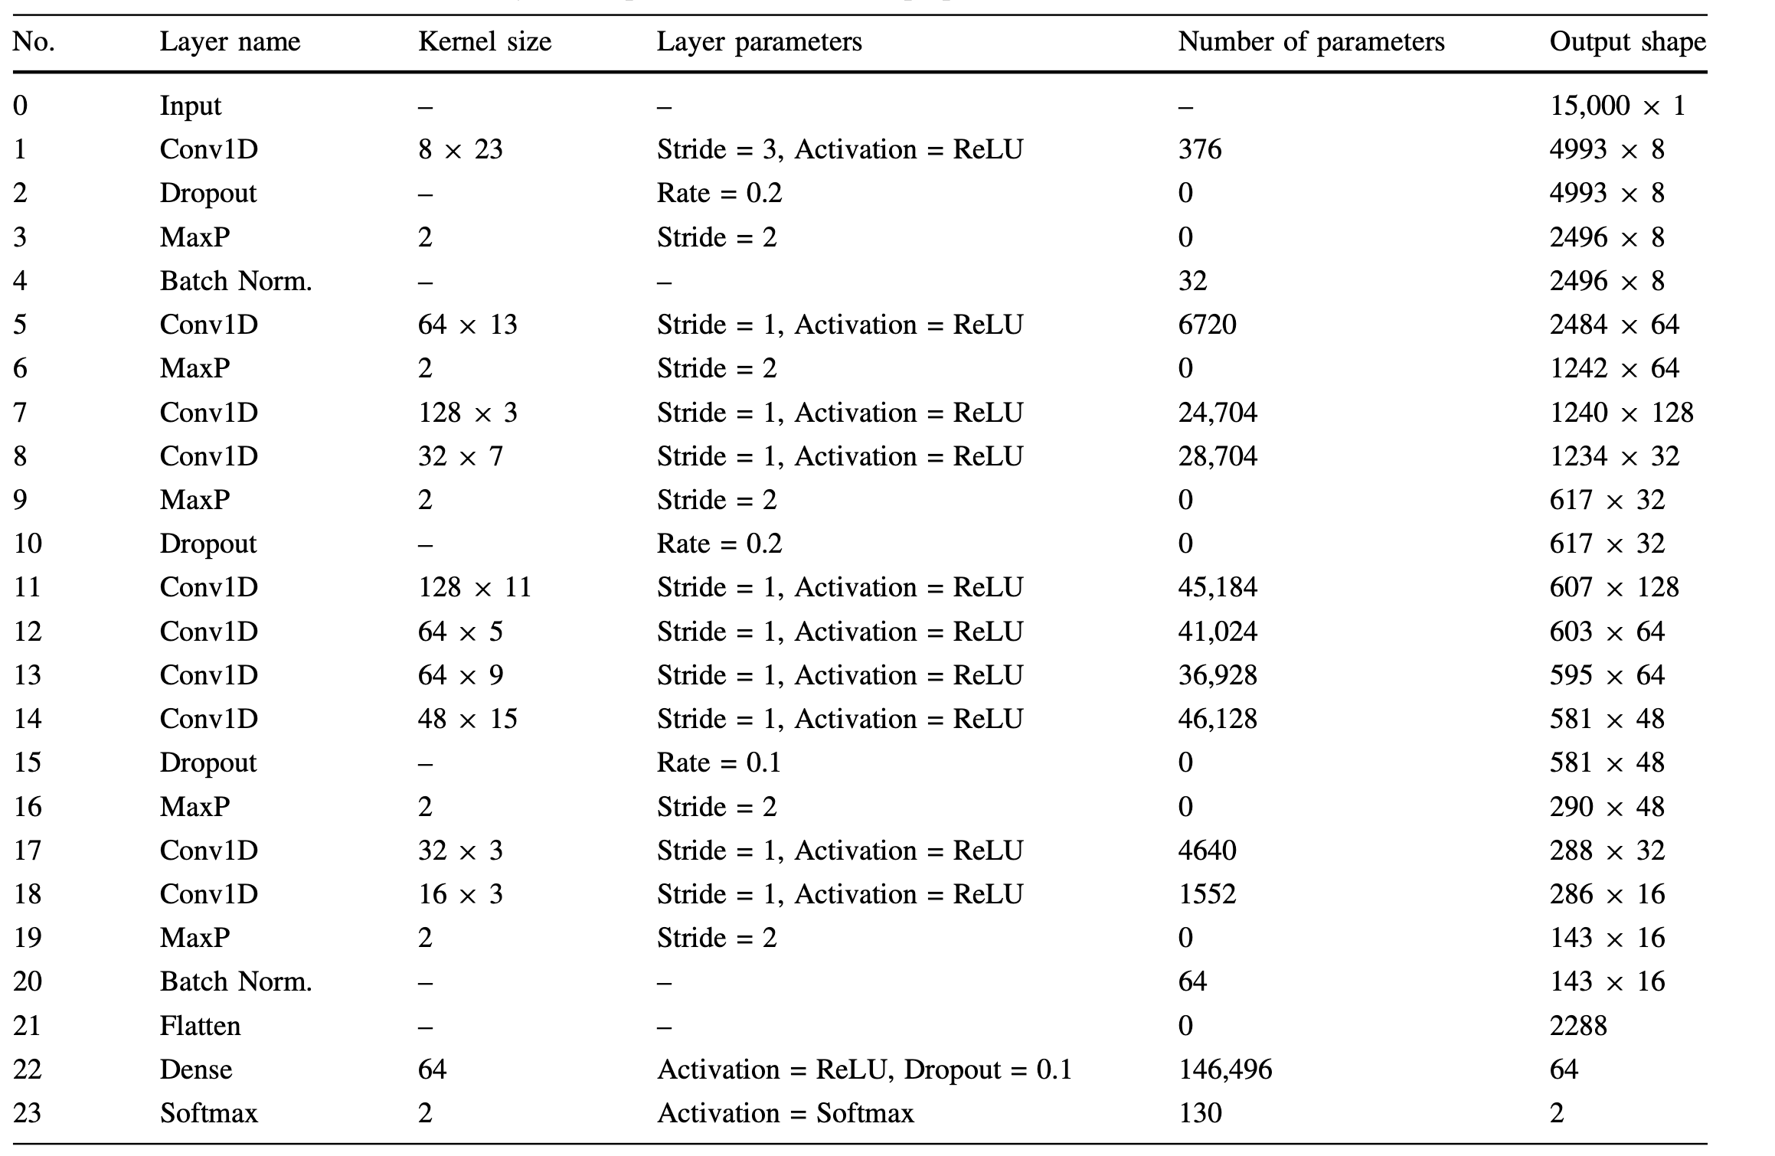
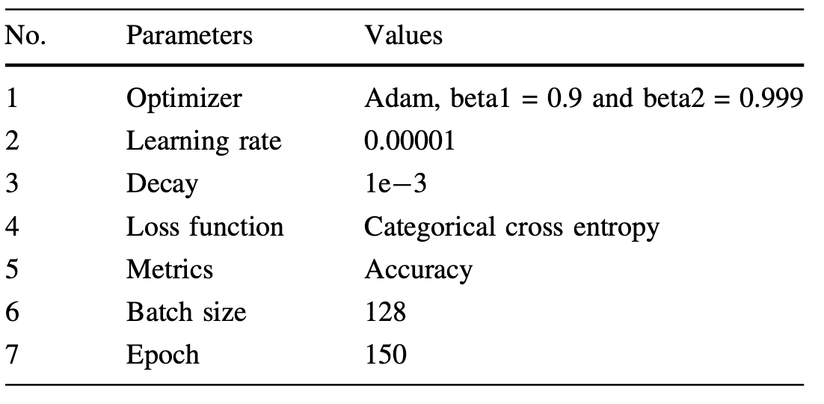

Slide 12
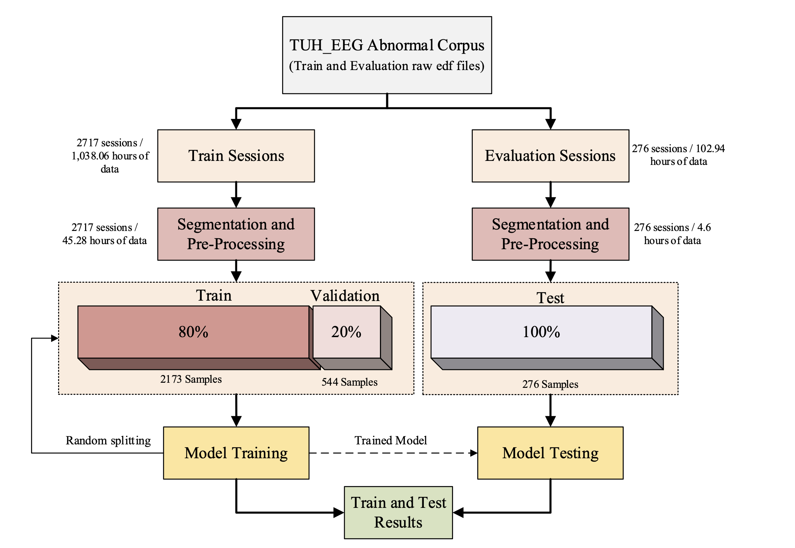

Slide 13
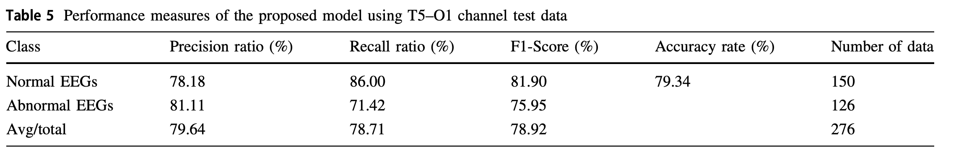
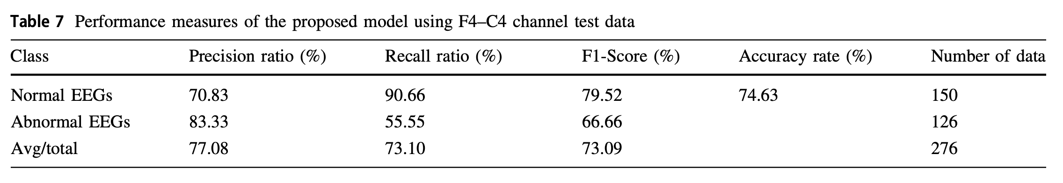

Slide 14
Automated EEG-based screening of depression using deep convolutional neural network https://www.sciencedirect.com/science/article/abs/pii/S0169260718301494?via%3Dihub
Task: Binary classification (yes/no depression)
Results
accuracies of 93.5% and 96.0% using EEG signals from the left and right hemisphere, respectively.
EEG signals
recording time = 5 minutes
sampling rate = 256 Hz
notch filter of 50 Hz to eliminate power line interference
Z-score normalization to overcome the amplitude scaling problem
segmentation
Each record consisting of 2,000 sampling points (7.8s)

Slide 15
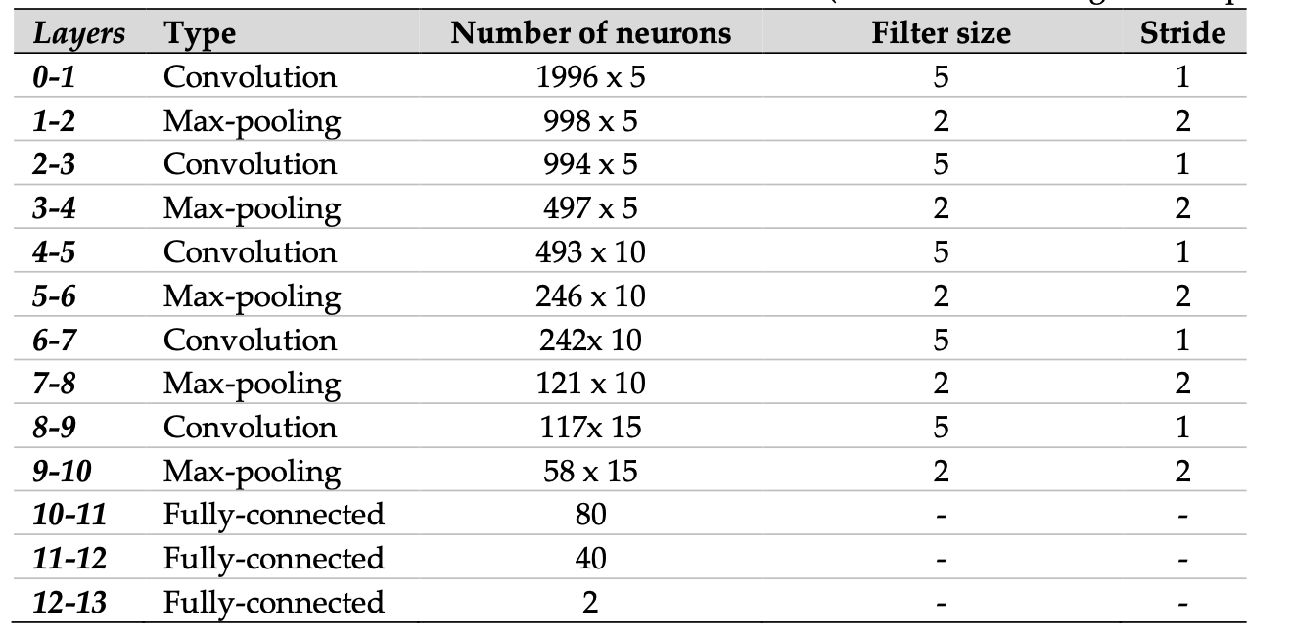
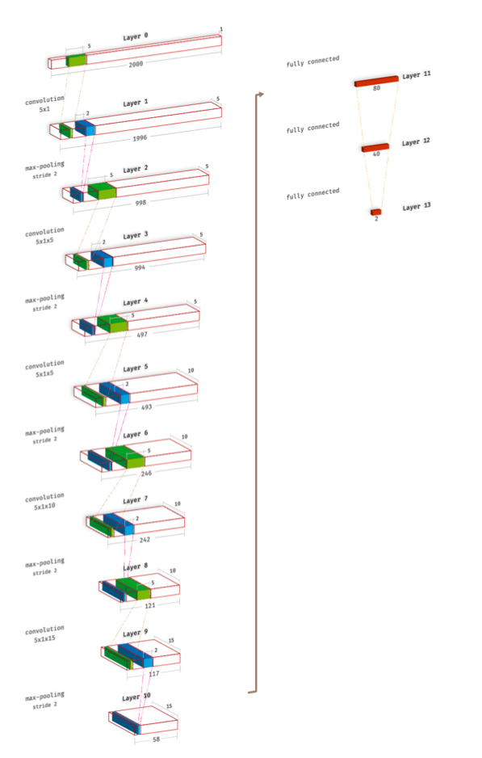
Model layers
convolution
batch normalization
max pooling
Dropout (only FC layers)
Leaky Relu
Softmax
Model training
batch size = 5
Adam
β1 = 0.9
β2 = 0.999
lambda = 0.2
learning rate = 0.0001
k-fold cross-validation

Slide 16
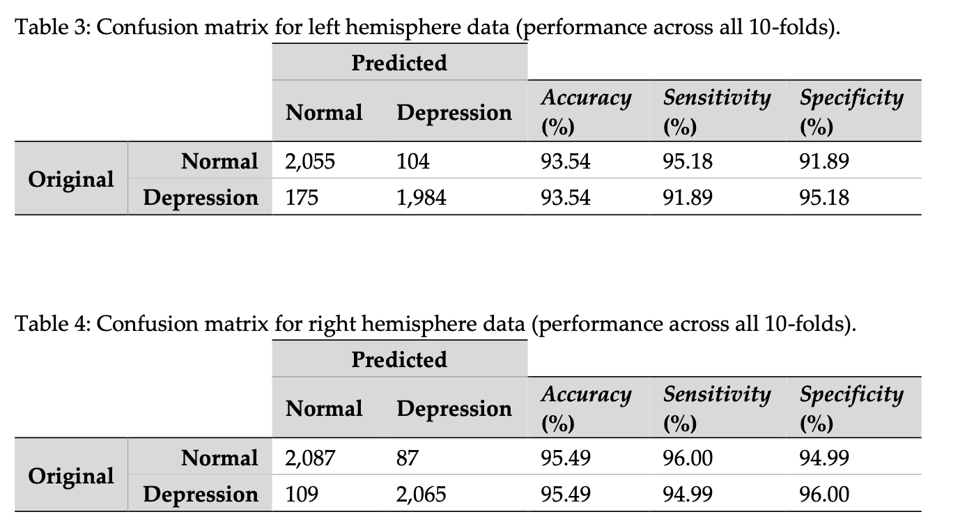
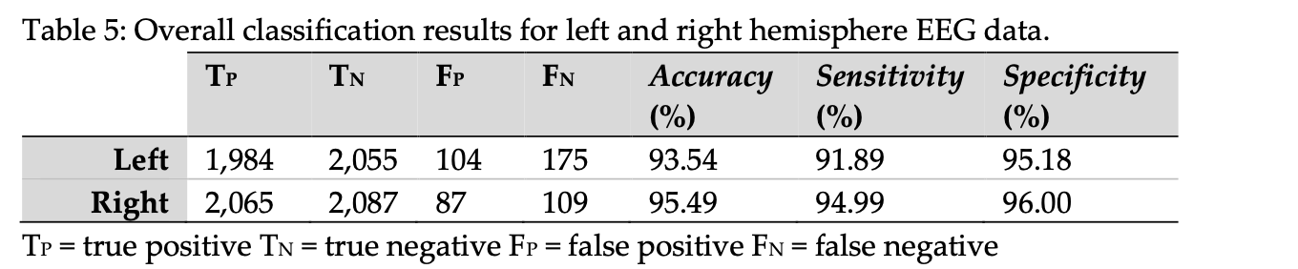

Slide 17
Deep convolutional neural network for the automated detection and diagnosis of seizure using EEG signals https://www.sciencedirect.com/science/article/abs/pii/S0010482517303153?via%3Dihub
Task: Binary classification (yes/no seizure)
Results
88.67% accuracy
95.00% sensitivity
90.00% specificity
EEG signals
Single-channel 300 EEG signals
duration of 23.6 seconds
Z-score normalization

Slide 18
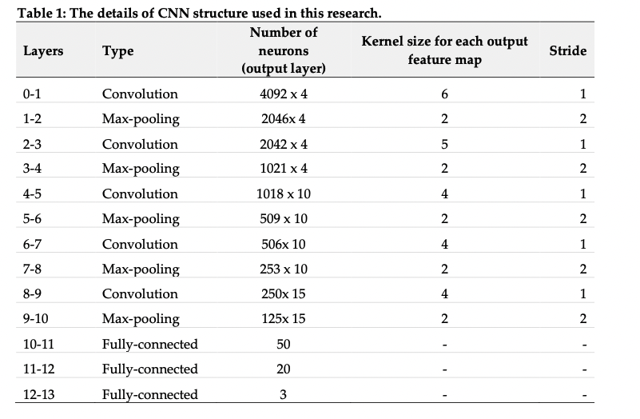
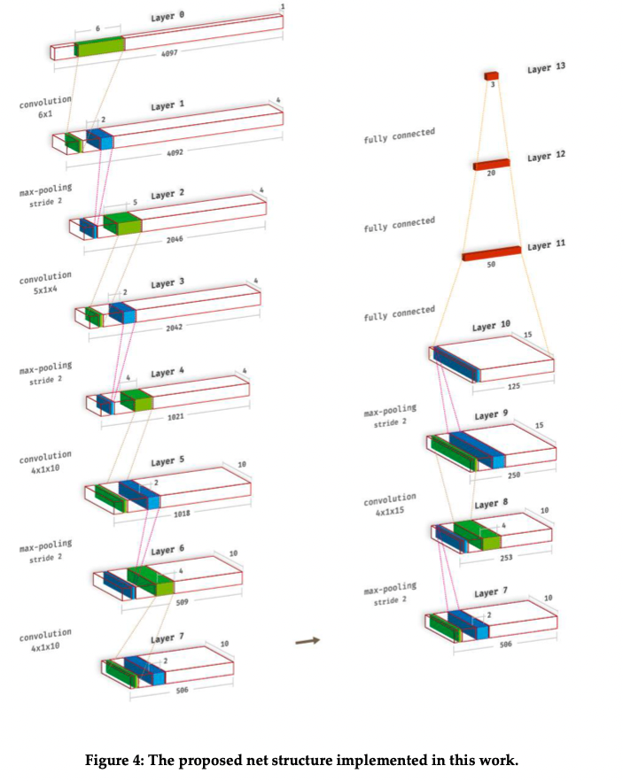

Slide 19
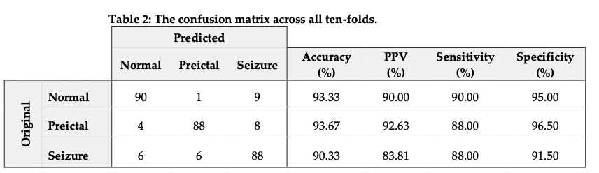
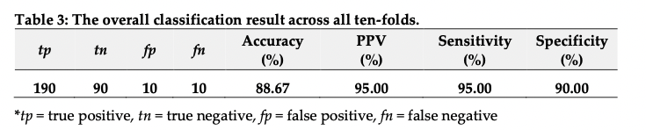

Slide 20
A Novel Convolutional Neural Network Classification Approach of Motor-Imagery EEG Recording Based on Deep Learning https://www.mdpi.com/2076-3417/11/21/9948
Task: Multiclass classification (Left hand/Right Hand/Tongue/Feet)
Results
88.67% accuracy
95.00% sensitivity
90.00% specificity
EEG signals
recording time = 5 min, sampling frequency = 250 Hz
bandpass filter (7–30 Hz)
50Hz notch filter to remove power-line noise
Extract frequency characteristics using Wavelet Packet Decomposition (WPD)
decomposition of the low-freq part and the high-freq part of the signal
Extract spatial characteristics using Common Spatial Pattern (CSP)

Slide 21
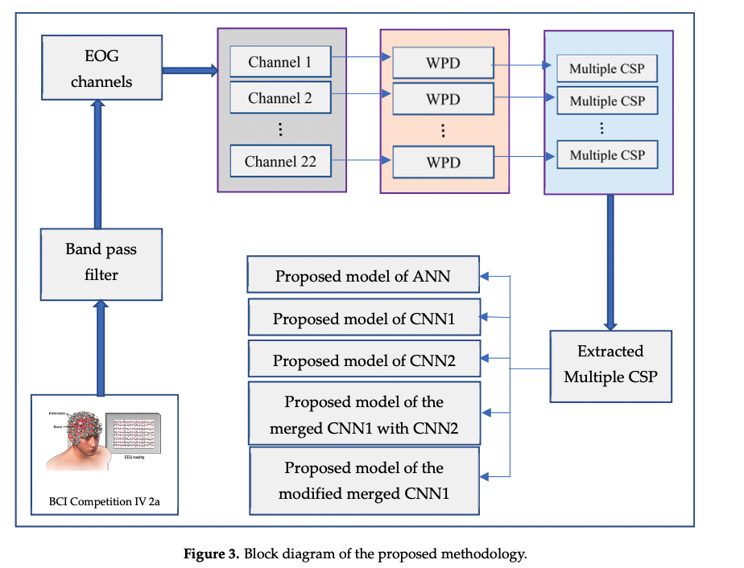

Slide 22
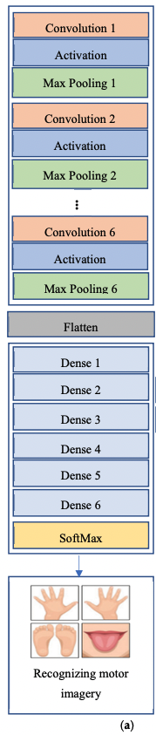
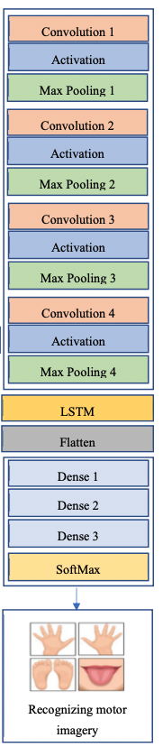
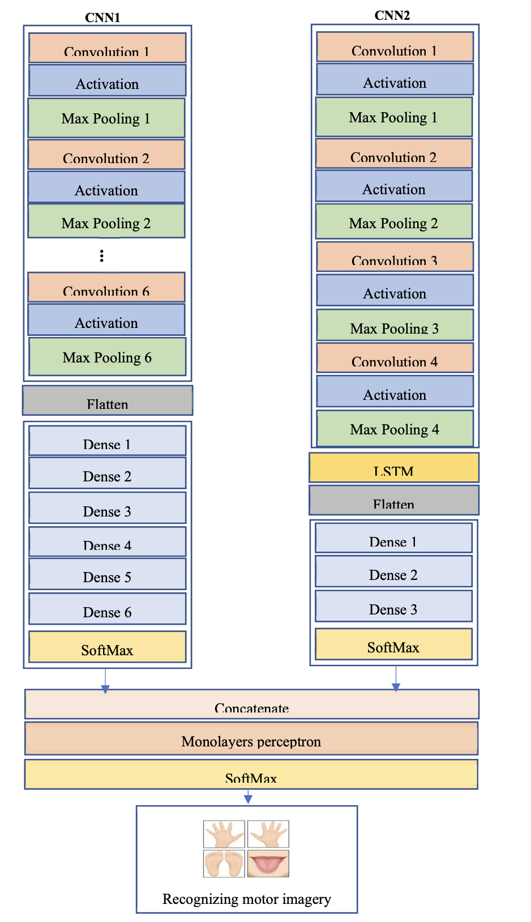
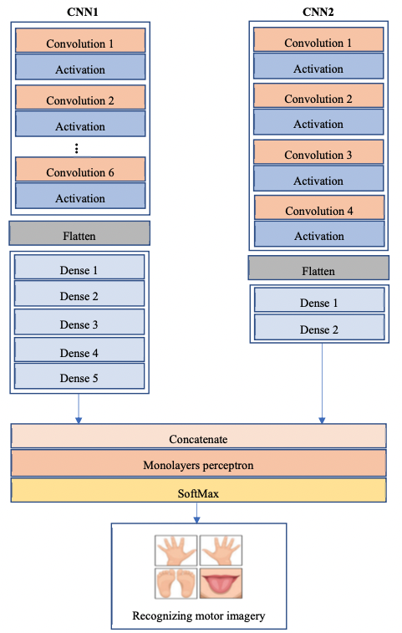
CNN 1
CNN+LSTM (CNN 2)
Merged CNNs
Modified Merged CNNs

Slide 23
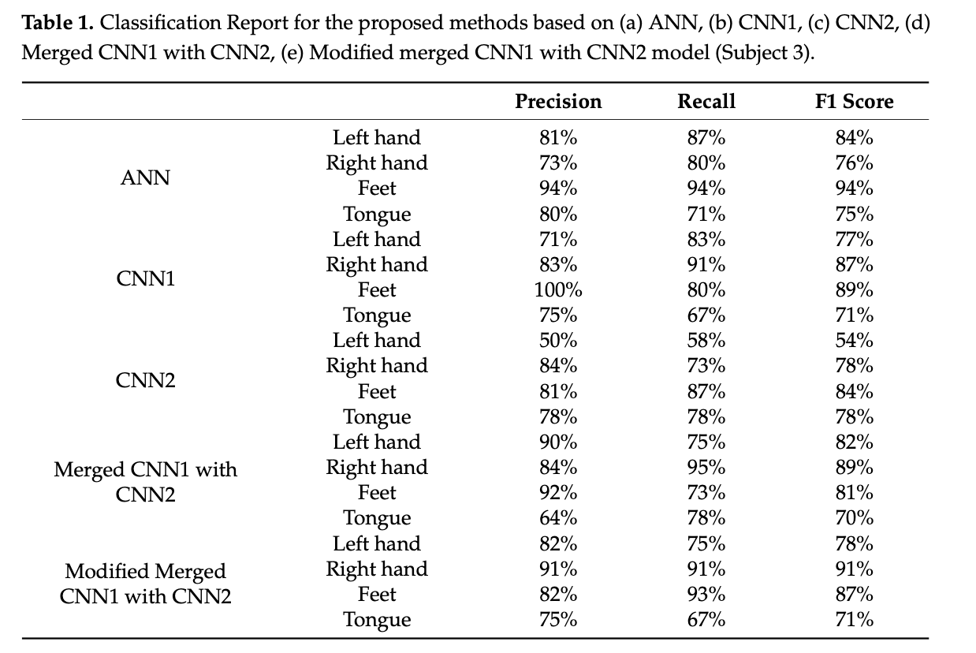
simple CNN models perform better
addition of the LSTM layers in the CNN model does not improve model

Slide 24
EEG Classification of Normal and Alcoholic by Deep Learning https://pubmed.ncbi.nlm.nih.gov/35741663/
Task: Binary classification (Normal/Alcoholic)
Results
Accuracy = 99.32%
Precision = 99.01%
Recall = 98.87%
F1-score = 98.93%
EEG signals
64 channels
Sampling frequency = 256Hz
standard deviation standardization

Slide 25
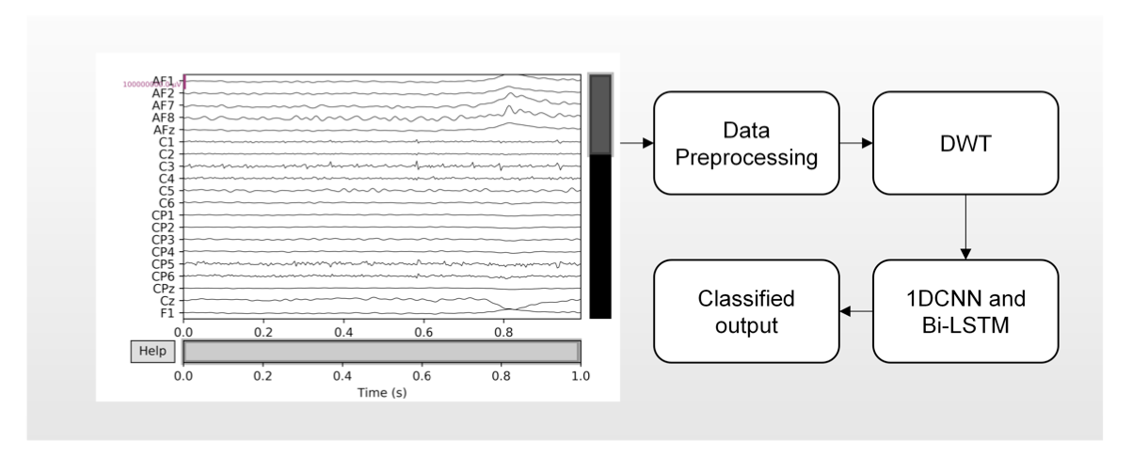
Data preprocessing (normalization)
discrete wavelet transform → extract time-frequency domain features
CNN + Bi-LSTM → extract spatiotemporal features
CNN → extract time-series patterns
Bi-LSTM → use previous/following time-series patterns to calculate output
classification

Slide 26
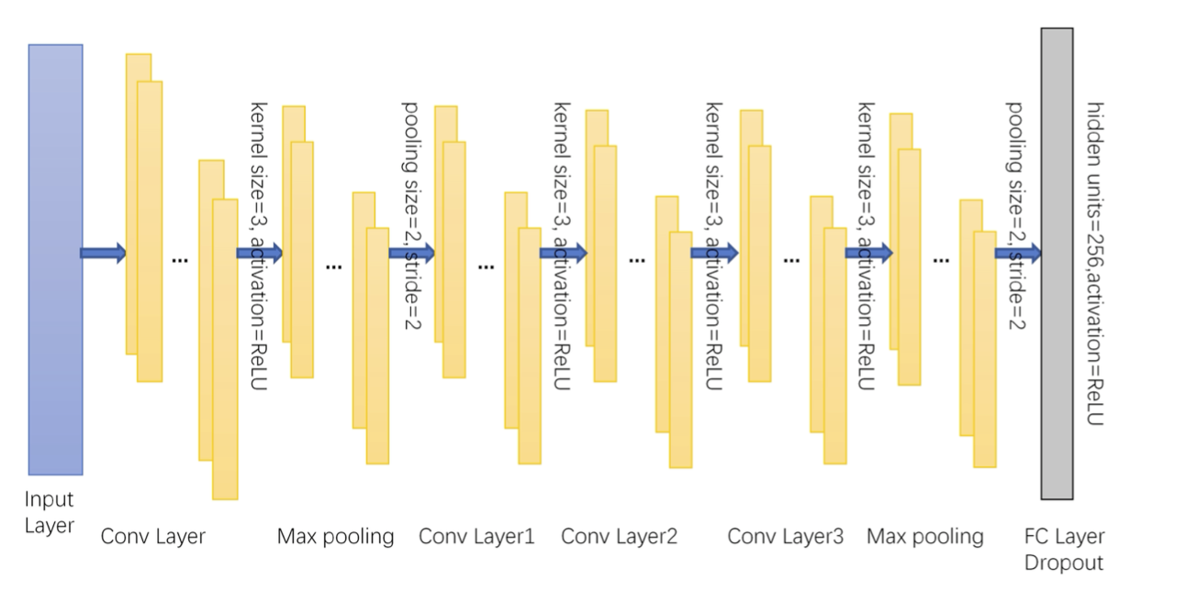
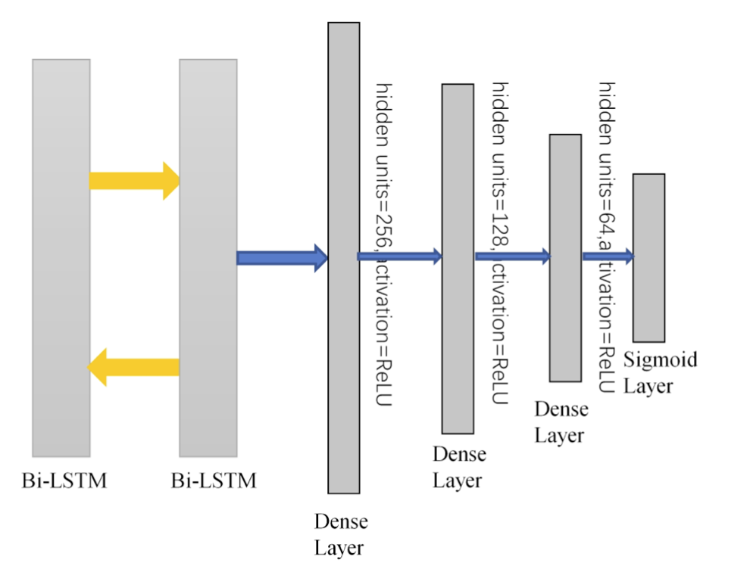
4 convolution layers (extract features)
1D conv
Size = 3x1
Stride = 1
ReLU
2 max pooling layers (reduce dimensionality)
Size = 2
Stride = 2
4 fully connected layers
1 sigmoid output layer.

Slide 27
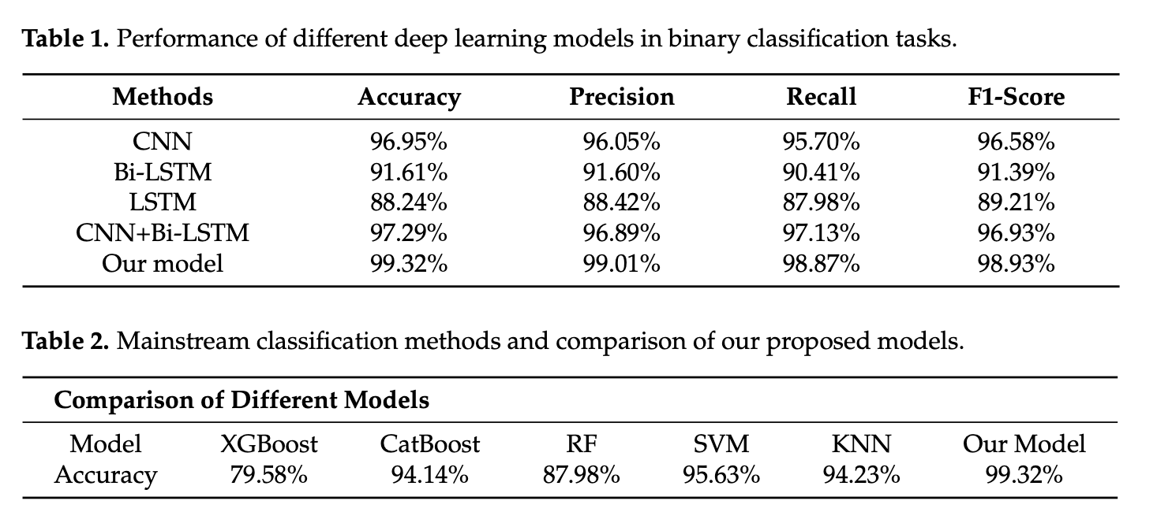

Slide 28
Scalp EEG-Based Pain Detection Using Convolutional Neural Network https://ieeexplore.ieee.org/stamp/stamp.jsp?arnumber=9696316
Task: Binary classification (Non-Pain/Pain)
Results
average AUC = 0.83
EEG signals
32 channels, sampling frequency = 250 Hz
band-pass filter (0.5Hz, 100Hz)
50Hz notch filter
Independent Component Analysis (ICA) for artifact removal
Segmentation
cropped into segments using a 5s sliding window with 4s overlap (5 seconds length segments)
1 segment = 1250 data points (250 x 5)

Slide 29
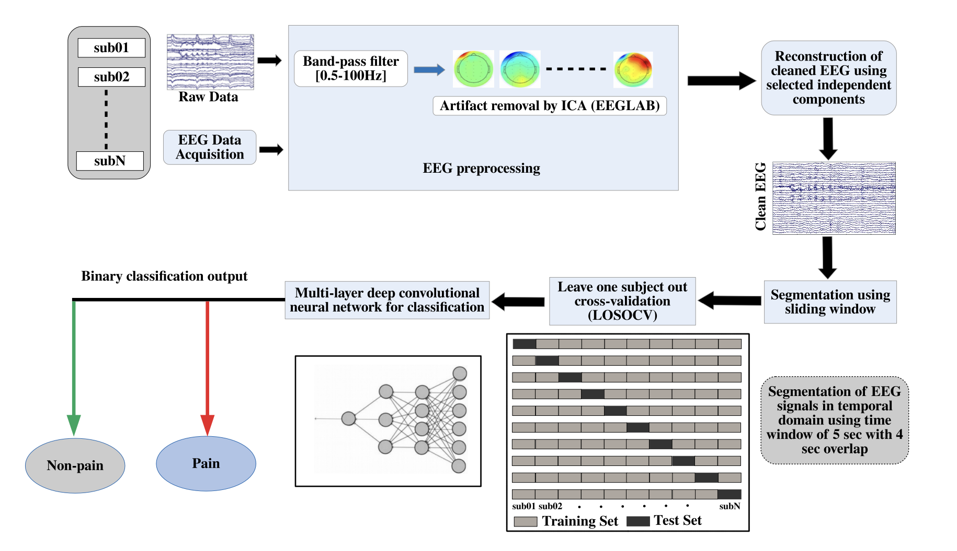

Slide 30
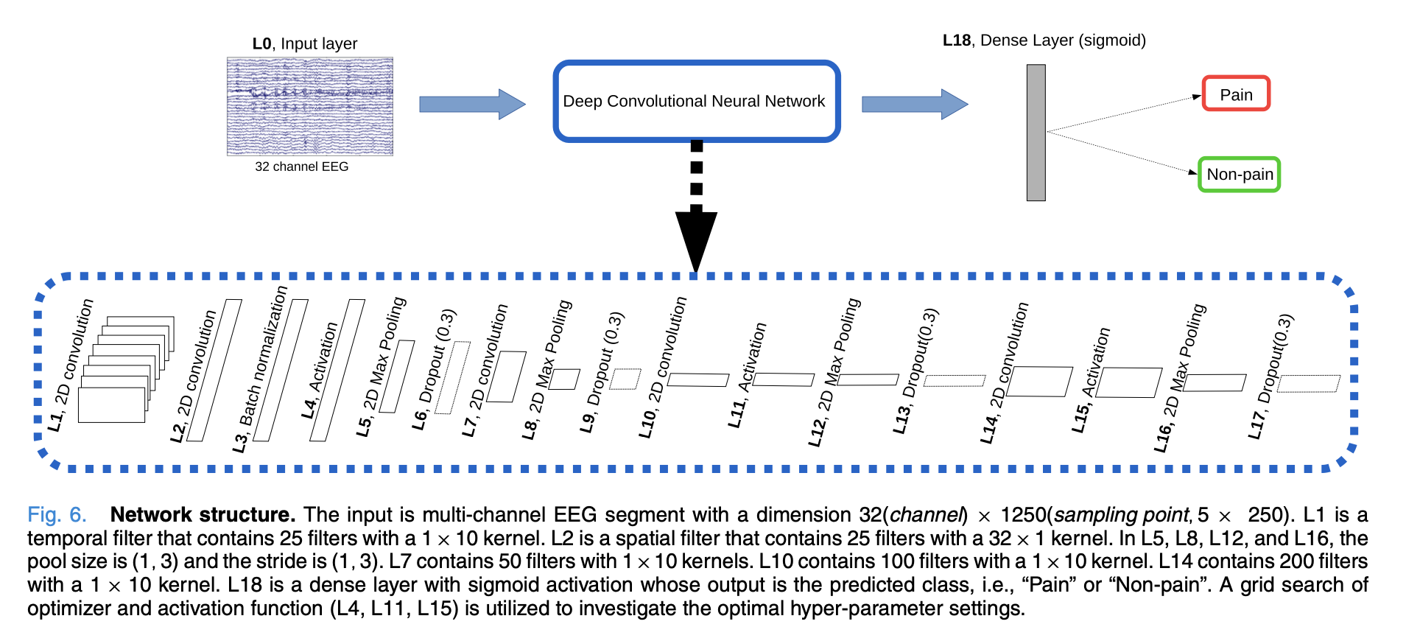
Grid search → Optimizer: SGD, activation function: ELU
convolutional layers (temporal filters, spatial filters)
Key point: EEG signals have temporal and spatial information
After each max-pooling layer, a 30% dropout is used to avoid overfitting

Slide 31
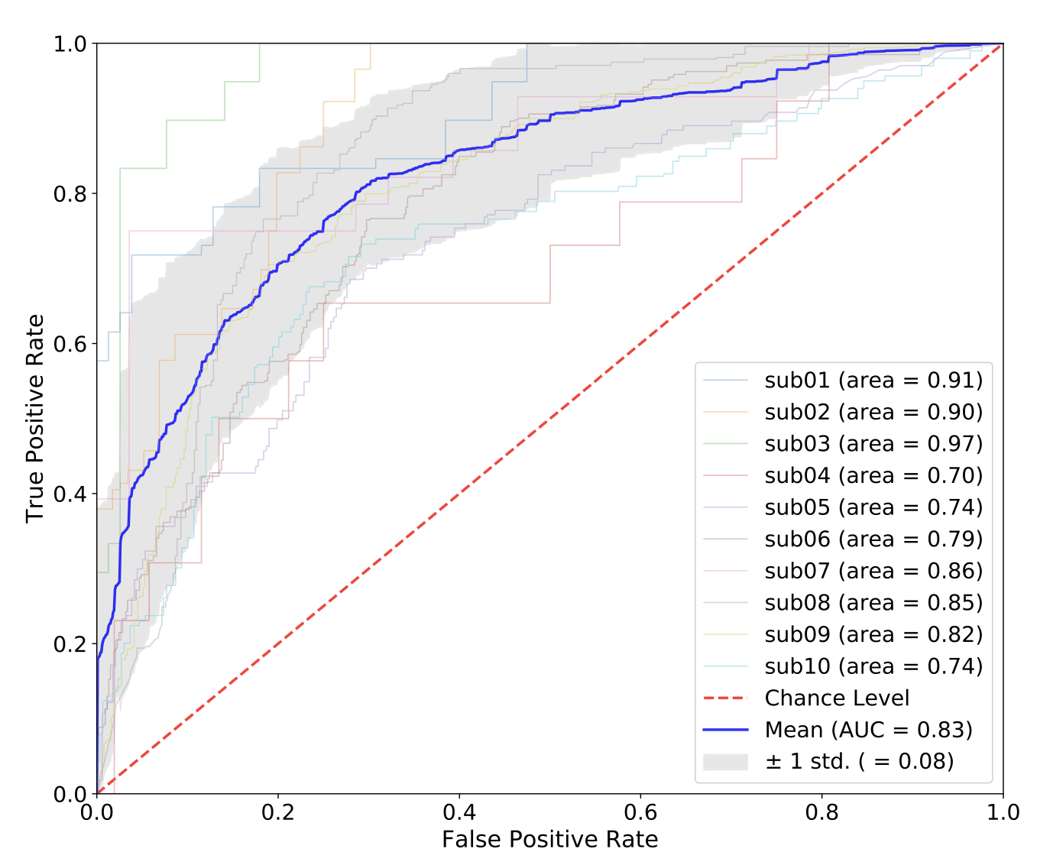

Slide 32
EEGNet: A Compact Convolutional Network for EEG-based Brain-Computer Interfaces https://arxiv.org/abs/1611.08024
Task: Multiclass classification
EEG signals
C channels, T time samples
band-pass filter (1Hz, 40Hz)
downsampling to 128 Hz → sampling frequency = 128Hz

Slide 33
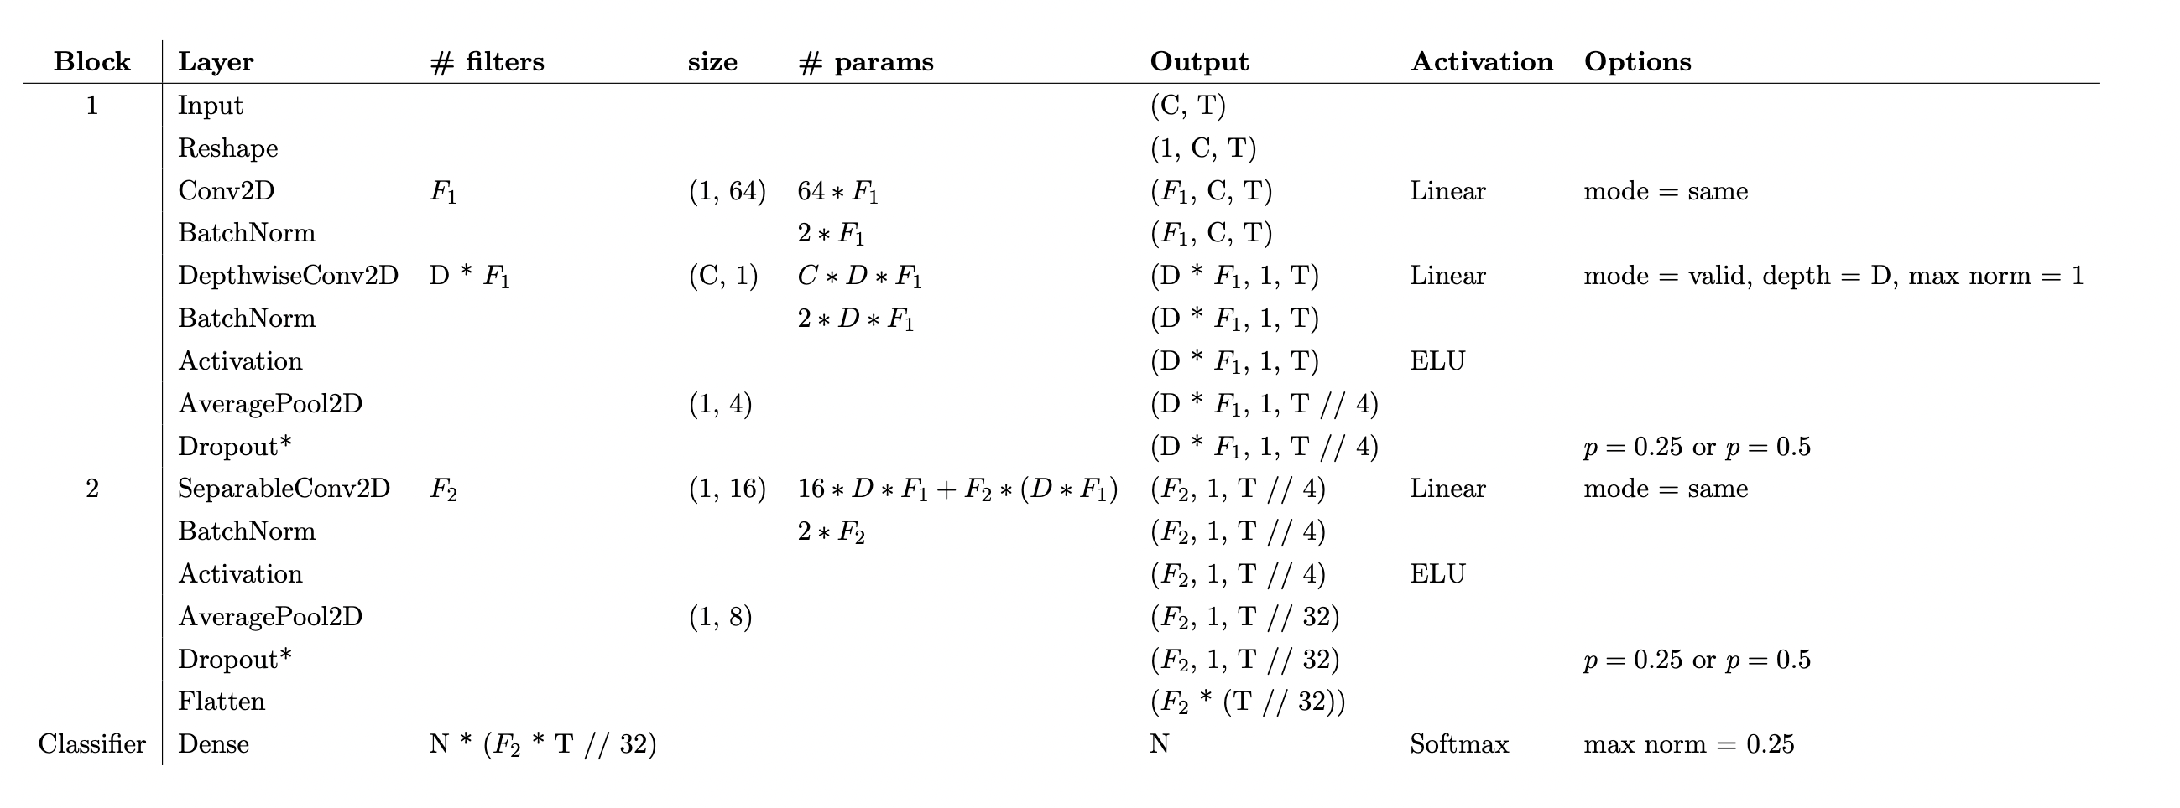
Model specs (EEGNet-F1,D)
First convolutions = Temporal filter + spatial filter
Temporal filter kernel size = (1, fs/2)
Setting the length of the temporal kernel at half the sampling rate allows for capturing frequency information at 2Hz and above.
spatial filter kernel size = (C, 1)
Training
Adam optimizer (with default parameters)
500 training epochs

Slide 34
